Slide 1
Exome sequencing : Practical aspects
GBIO0009-1 Bioinformatic
VAN STEEN K.
BESSONOV K.
MOTTART Xavier
THOMAS Julien

Slide 2
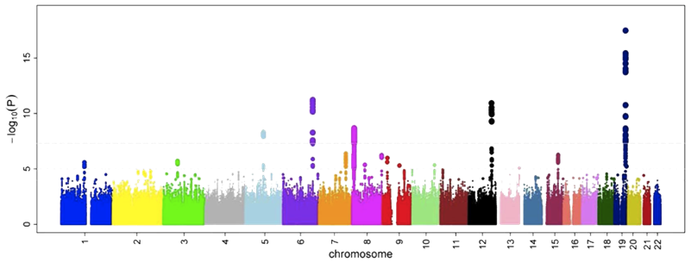
introduction
Since the beginning : GWAs
« Examination of many common genetic variants in different individuals to see if any variant is associated with a trait. »
Suffer from several limitations
© Ikram MK et al (2010) Four Novel Loci

Slide 3
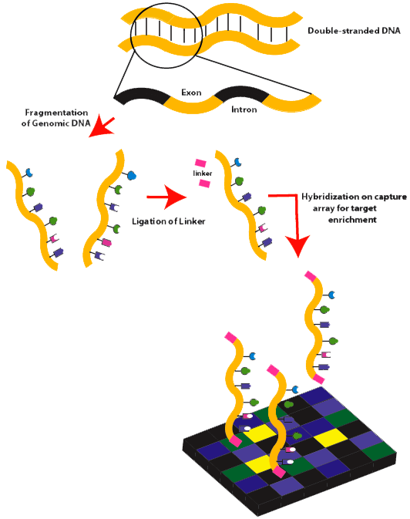
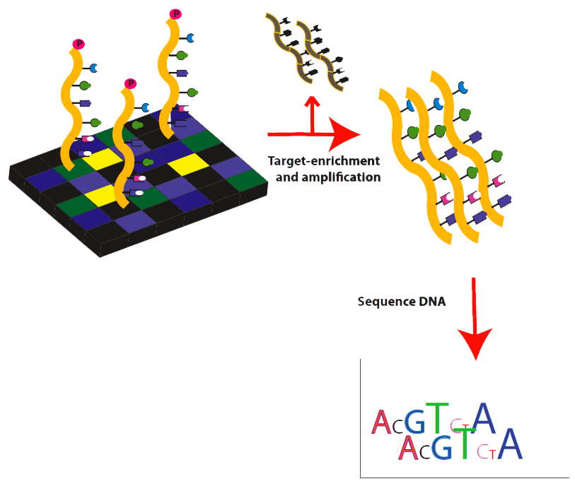
Introduction
New technologies and methods Exome sequencing
« Exome sequencing is a efficient strategy to selectively sequence the coding regions of the genome as a cheaper but still effective alternative to the whole genome sequencing. »
© Wikipedia: Exome sequencing
Notes:
Exons are short, functionally important sequences of DNA which represent the regions in genes that are translated into protein. In the human genome there are about 180,000 exons. These constitute about 1% of the human genome.
This technology is not only used in the research of complex diseases such as diabetes, obesity, cancer, and monogenic diseases, but is also considered an effective method for rapid screening of Mendelian heritable diseases.

Slide 4
Table of content
Sample selection
Sequencing strategy
Variant calling
Association analysis
Approaches for follow-up of promising signals
The role of functional assays in interpreting exome-sequencing studies
Conclusions
1
2
3
4
5
6
7

Slide 5
Sample selection
Three rules for a good selection of sample :
Samples whose outcomes are ‘unusual’
Sample whose relatives have similarly extreme phenotypes or a history of disease
Careful to restricted geographic distribution

Slide 6
Sequencing strategy
High specificity identification of the whole protein coding regions
Don’t neglect off-target
Coverage is the average number of reads representing a given nucleotide in the reconstructed sequence.
Notes:
It is possible to identify the whole protein-coding regions with high specificity with a coverage to reach 20x or greater in 80% - 95% of the coding sequence of genome. Moreover, it is beneficial to analyse the “off-target” which are usually neglected with a light coverage because they can used to estimate the ancestry to each sample to facilitate detection of large structural variants.

Slide 7
Variant Calling
Alignments – Calibration – Exclude duplicates
Examine per sample quality metrics
Distribution of quality scores and relationships
Identification of variants size
Machine inspection
Re-examine per sample quality metrics
Comparison of transition-transversion ratio
Validation
Check : DNA fingerprint - Sample tracked - Contamination
Notes:
This step consist in the Alignment of short sequence reads to reference genome, calibration of base quality scores and removal duplicate reads. Then, they propose to evaluating the distribution of empirical base quality scores and relationship between coverage and GC content to excluded/flagged/reprocessed data with outlier properties. Finally, we arrive to the Identification of variant site with the overlapping reads. A machine that tries to separate polymorphic from artefact to see false positive variants inspects these variant sites. The last steps are a re-examination of the quality metrics and a comparison of the transition-transversion ratio of the new and previously described variants to overcome to a validation of new variants if sufficient resources are avaible.

Slide 8
Association analysis
Association analysis test
Rare variant test
group the variant that might have the same impact on the function of a specific gene and to compare the distribution of these variant groupings to the distribution of the trait of interest
The total number of rare alleles across a gene are compared between cases and controls
Single variant association test
Allow us to check that previously reported common variant signals are reproduced and to inspect genome wide QQ-plot to ensure samples are adequately matched and results are not unduly influenced by population structure
Examine whether the number of variants with non-zero effects sizes exceeds chance expectation

Slide 9
Approaches for follow-up of promising signals
Rare variants where MAF < 0,01
Selection
Imputation
Larger samples

Slide 10
The role of functional assays in interpreting exome-sequencing studies
Functional characterization can :
help to interpret rare variant association signal
Mechanism
Disease causes
To use carefully

Slide 11
Conclusions

Slide 12
References
[1] Exome sequencing and complex disease: practical aspects of rare variant association studies Ron Do, Sekar Kathiresan and Gonc ̧alo R. Abecasis
[2] http://en.wikipedia.org/wiki/Deep_sequencing
[3] http://en.wikipedia.org/wiki/Genetic_variant
[4] http://www.medscape.com/viewarticle/728457

